Slide 1




Statistical Methods for
Estimating Abundance in Ecology

Slide 2
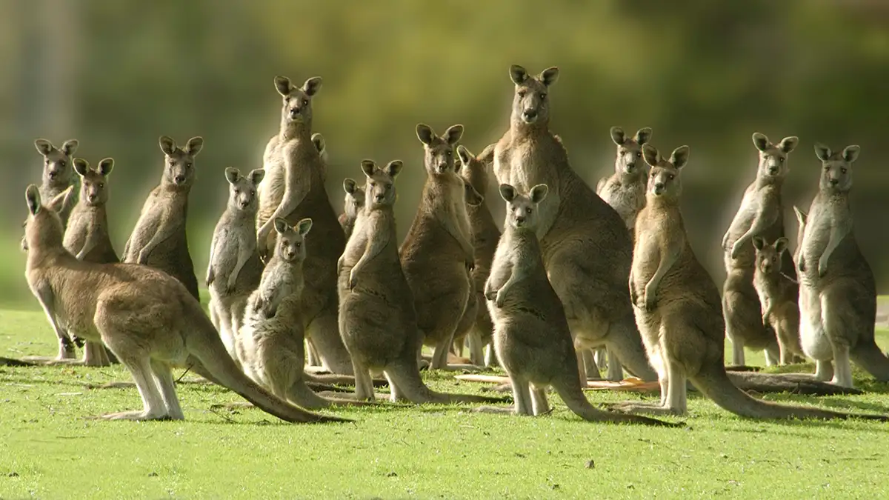
Abundance in Ecology
John Carnemolla

Slide 3
Three approaches to modeling abundance
N-mixture models
Distance sampling
Capture-mark-recapture

Slide 4
Three approaches to modeling abundance
Variable | Marked | Data | Approach | Package | Model
Abundance/Density | No | Count (repeated) | N-mixture | unmarked | Closed Binomial N-mixture
Abundance/Density | No | Count (by distance interval) | Distance Sampling | unmarked | Multinomial-Poisson mixture
Abundance/Density | Yes | Capture-recapture | Capture-mark-recapture | RMark | Closed Population Estimation

Slide 5
Three approaches to modeling abundance
Variable | Marked | Data | Approach | Package | Model
Abundance/Density | No | Count (repeated) | N-mixture | unmarked | Closed Binomial N-mixture
Abundance/Density | No | Count (by distance interval) | Distance Sampling | unmarked | Multinomial-Poisson mixture
Abundance/Density | Yes | Capture-recapture | Capture-mark-recapture | RMark | Closed Population Estimation

Slide 6
Three approaches to modeling abundance
Variable | Marked | Data | Approach | Package | Model
Abundance/Density | No | Count (repeated) | N-mixture | unmarked | Closed Binomial N-mixture
Abundance/Density | No | Count (by distance interval) | Distance Sampling | unmarked | Multinomial-Poisson mixture
Abundance/Density | Yes | Capture-recapture | Capture-mark-recapture | RMark | Closed Population Estimation
Is distance from observer a major source of variation in detection probability?

Slide 7
Three approaches to modeling abundance
Variable | Marked | Data | Approach | Package | Model
Abundance/Density | No | Count (repeated) | N-mixture | unmarked | Closed Binomial N-mixture
Abundance/Density | No | Count (by distance interval) | Distance Sampling | unmarked | Multinomial-Poisson mixture
Abundance/Density | Yes | Capture-recapture | Capture-mark-recapture | RMark | Closed Population Estimation

Slide 8
Three approaches to modeling abundance
Variable | Marked | Data | Approach | Package | Model
Abundance/Density | No | Count (repeated) | N-mixture | unmarked | Closed Binomial N-mixture
Abundance/Density | No | Count (by distance interval) | Distance Sampling | unmarked | Multinomial-Poisson mixture
Abundance/Density | Yes | Capture-recapture | Capture-mark-recapture | RMark | Closed Population Estimation
We focus on closed systems (geographically & demographically) and frequentist approaches. However, if you are interested in Bayesian approaches and/or modeling change in abundance over time, we will direct you to some helpful resources.

Slide 9


Estimating Abundance – Imperfect Detection
How does grass cover influence bunny rabbit abundance?

Slide 14
Estimating Abundance – Imperfect Detection
Our Data
Reality

Slide 15
Estimating Abundance – Imperfect Detection
Our Data
Reality
Observation Process (Detection Probability)
but could be incorrectly modeled as abundance (e.g., Poisson GLM)
State Process (Population Size)
‘true abundance’

Slide 16
Estimating Abundance – Imperfect Detection
1
0
Observation Process (Detection Probability)
but could be incorrectly modeled as abundance (e.g., Poisson GLM)
State Process (Population Size)
‘true abundance’

Slide 17
Estimating Abundance – State and Observation Processes
1. State process (e.g., population size)
2. Observation process (e.g., population count)
For example, the state process describes the dynamics of population size over time (N_{t}), whereas the observation process describes the error-prone population counts (C_{t}).

Slide 18
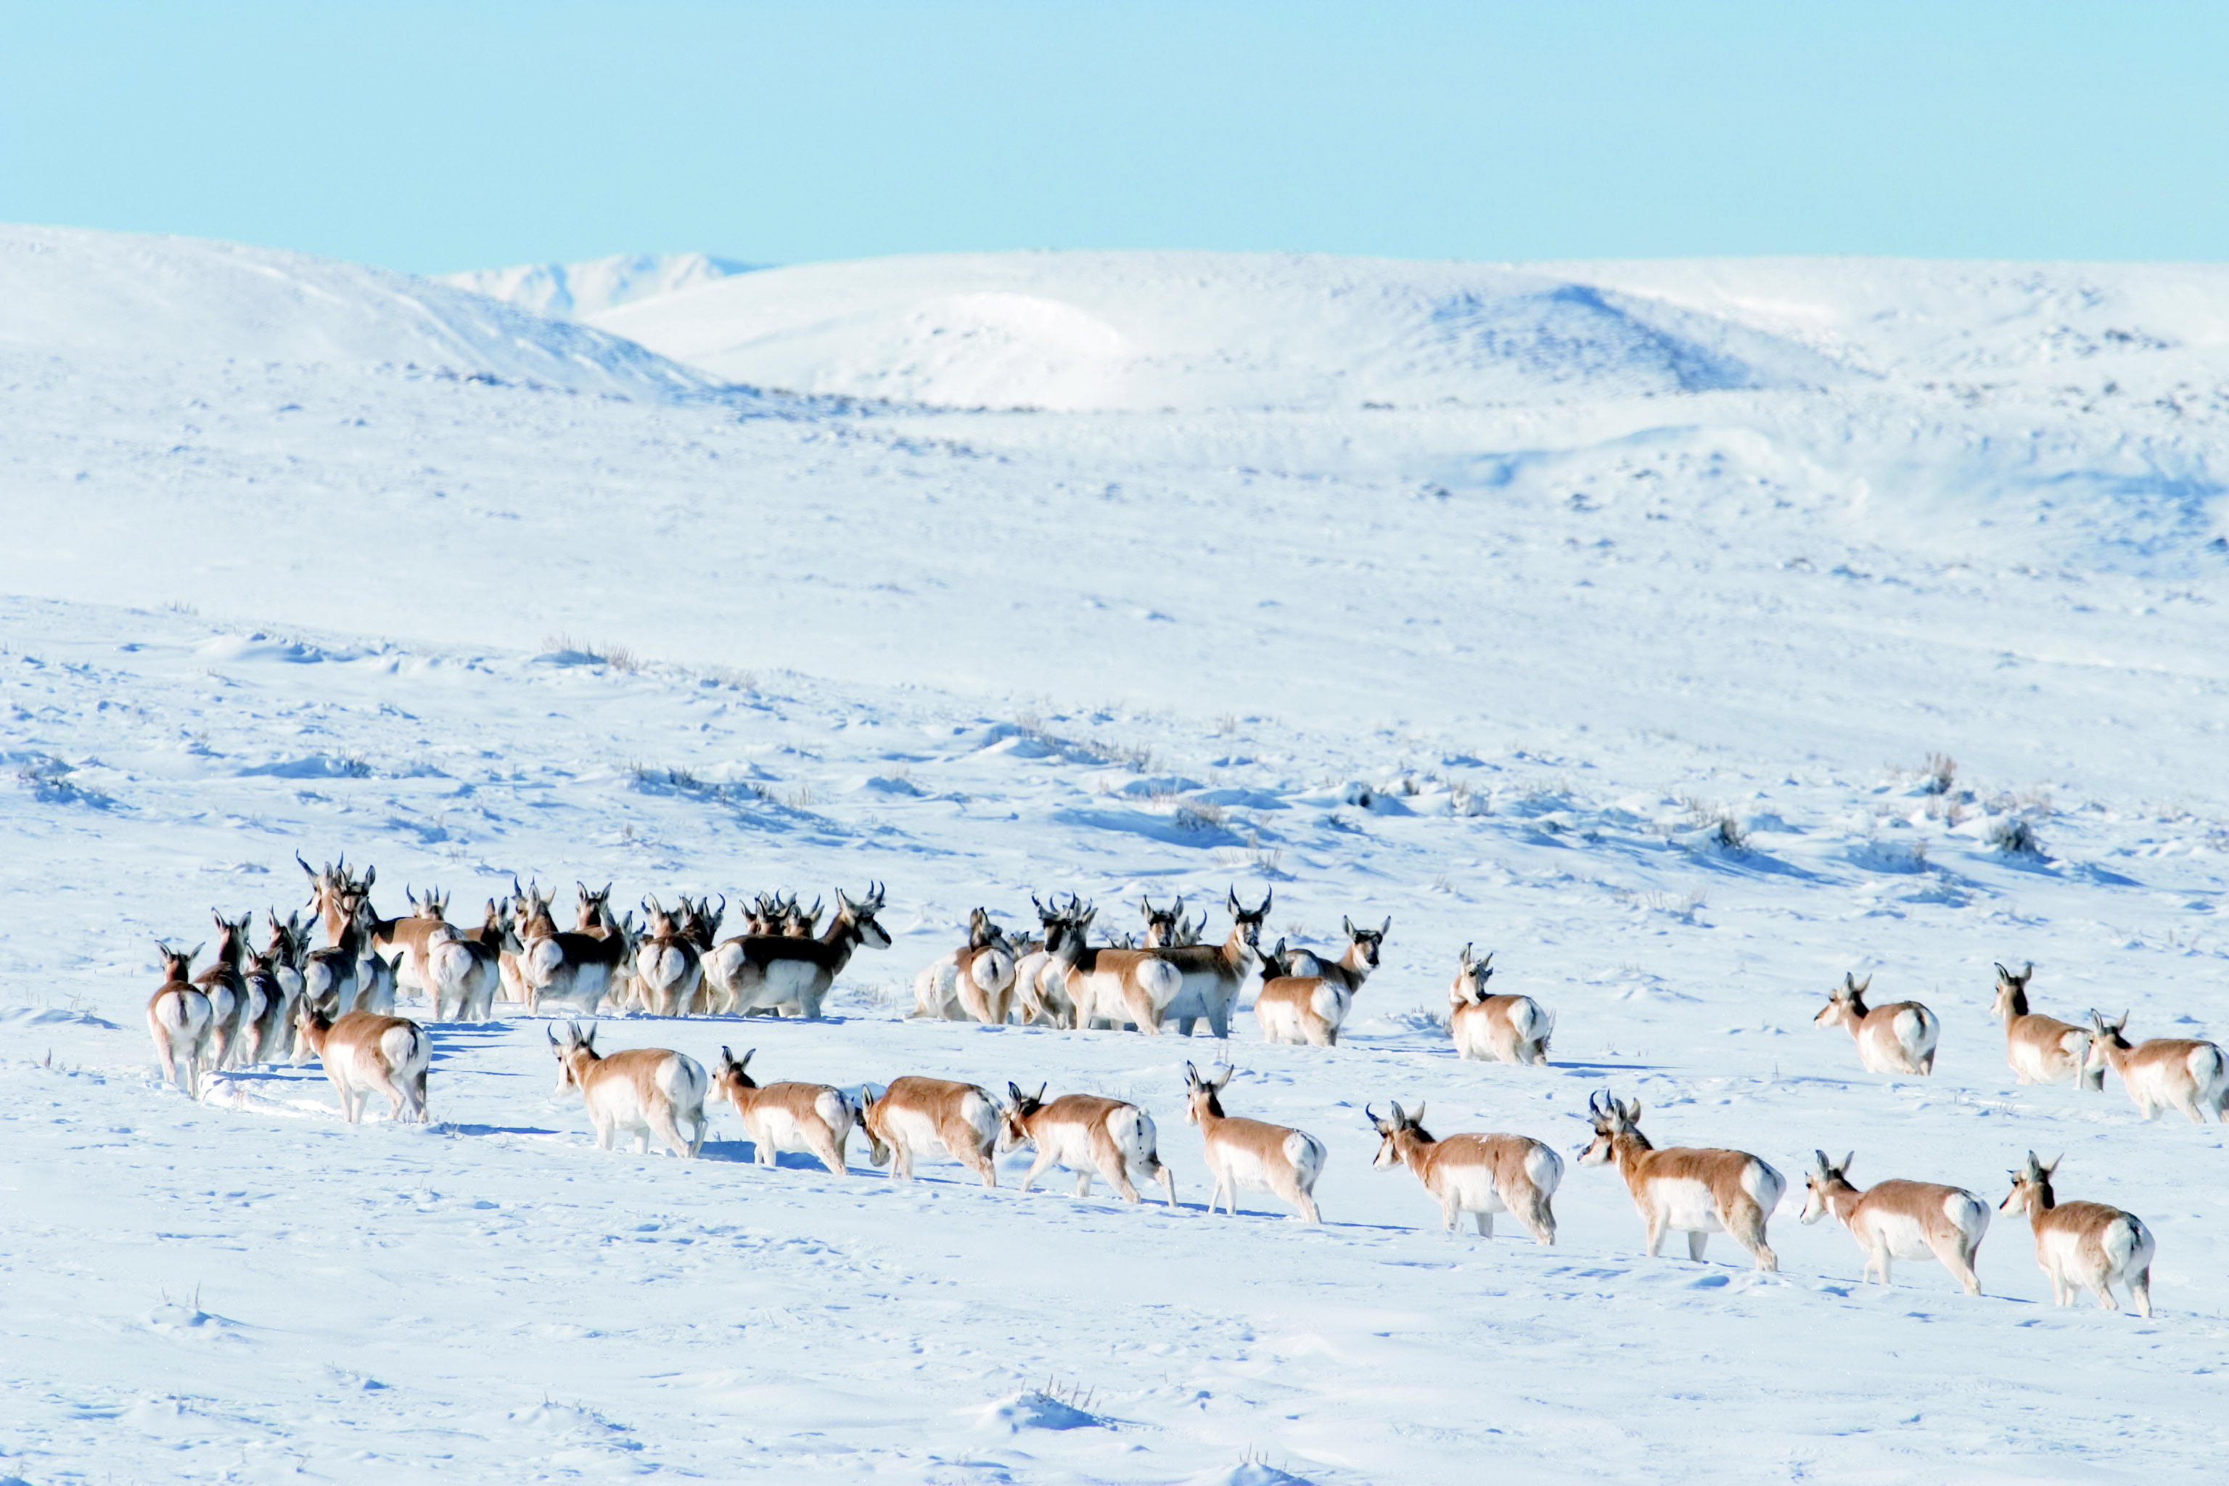
Estimating Abundance – Closed Binomial N-mixture Model
Mark Gocke

Slide 19
Estimating Abundance – Closed Binomial N-mixture Model
C = 45
N = 60
Count = true abundance * detection probability
C = N * p
45 = 60 * p
45/60 = p
Detection probability is 0.75
C/p = N
45/0.75 = 60
1. Observation Process C ~ Binomial(N, p)
2. State Process N ~ Poisson(λ)

Slide 20
Estimating Abundance – Closed Binomial N-mixture Model
1. Question
2. Field Data
3. Format Data for Analysis
4. Fit Population Model
5. Examine Output and Visualize Results
*steps 3-5 in Program R

Slide 21
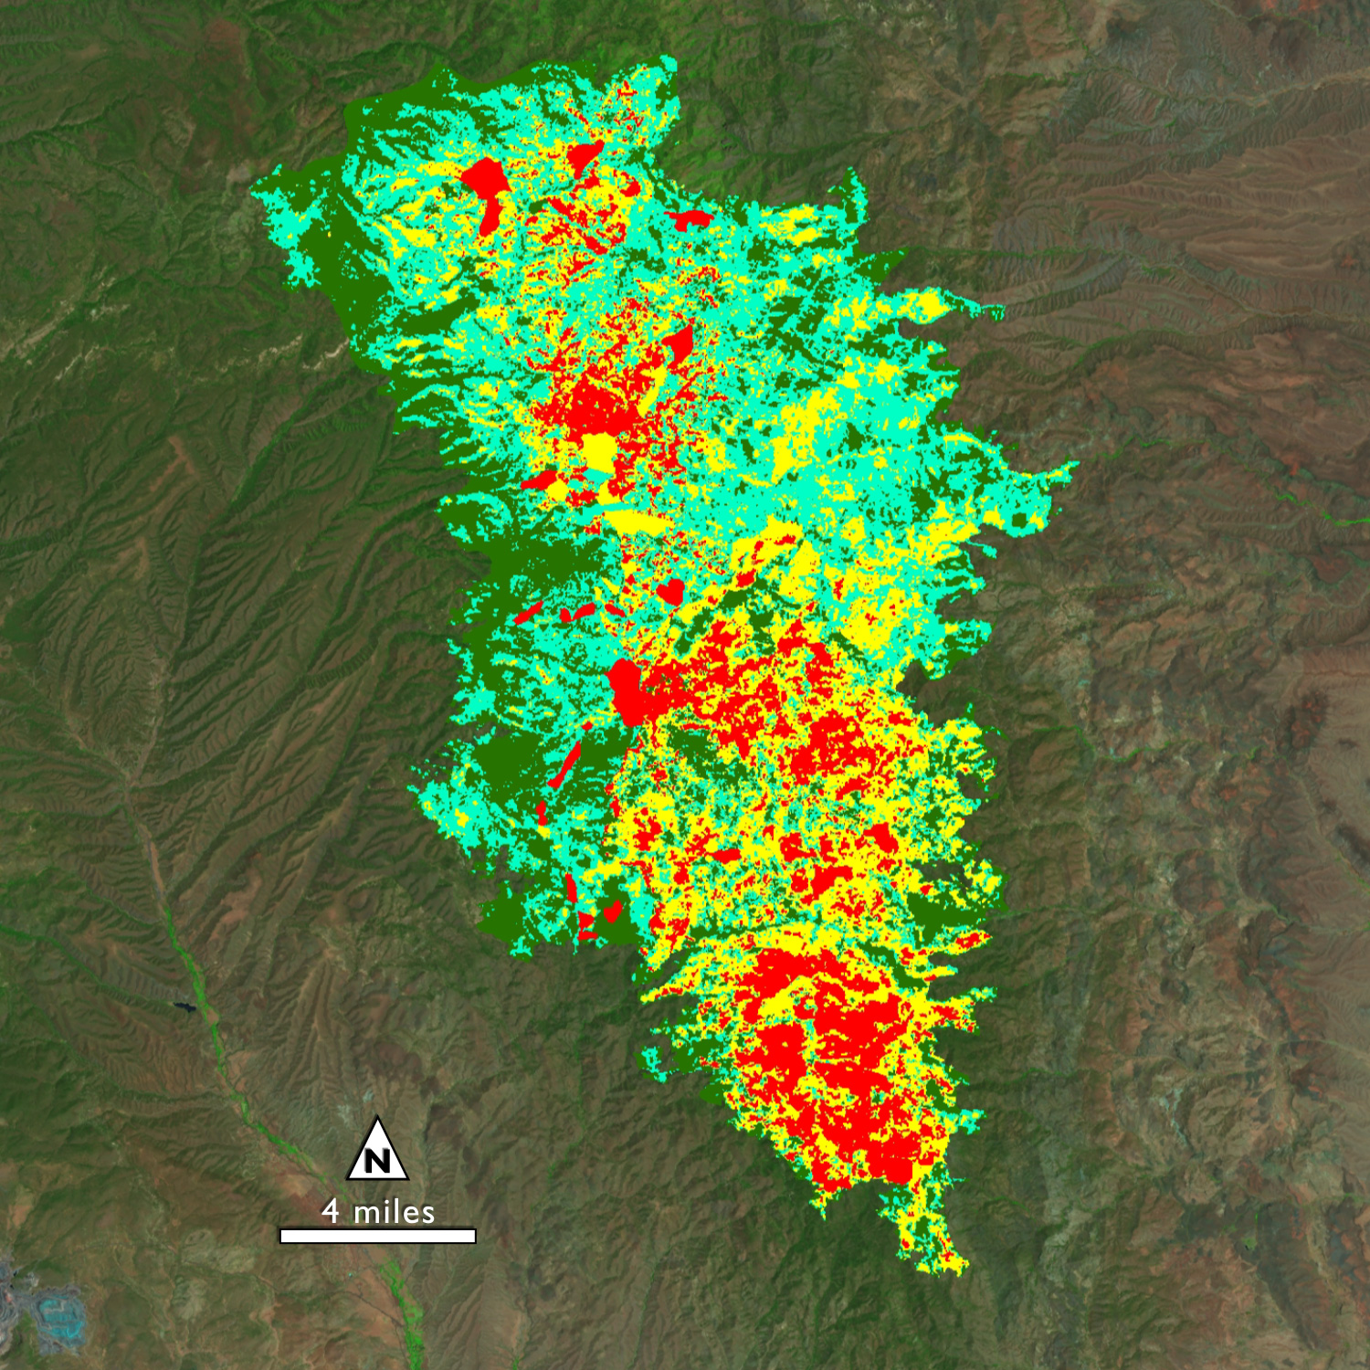
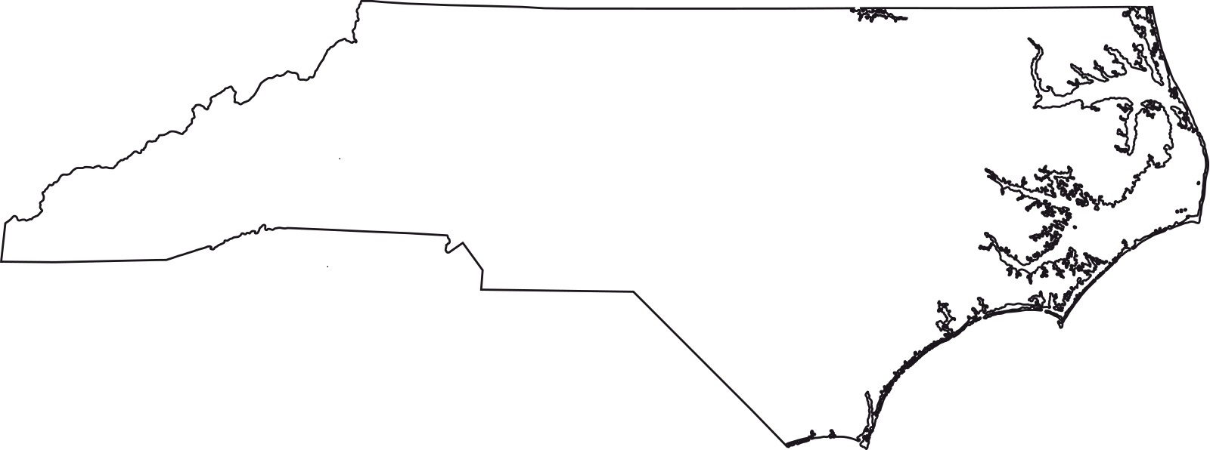
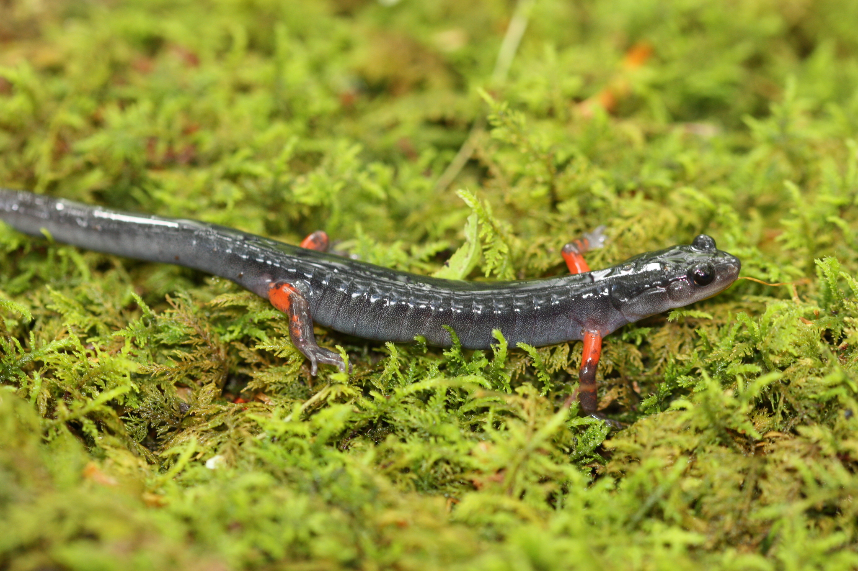
Estimating Abundance – Closed Binomial N-mixture Model
1. Question
How does wildfire influence salamander abundance?
x
iNaturalist, USDA Forest Service, Burned Area Emergency Response Team

Slide 22
Estimating Abundance – Closed Binomial N-mixture Model
1. Question
How does wildfire influence salamander abundance?
x
iNaturalist, USDA Forest Service, Burned Area Emergency Response Team

Slide 23
Estimating Abundance – Closed Binomial N-mixture Model
1. Question
How does wildfire influence salamander abundance?
2. Field Data
Date | Transect | Survey | Count | % Burned Area | Time of Day
iNaturalist, USDA Forest Service, Burned Area Emergency Response Team

Slide 24
Estimating Abundance – Closed Binomial N-mixture Model
1. Question
How does wildfire influence salamander abundance?
2. Field Data
Date | Transect | Survey | Count | % Burned Area | Time of Day
6/1/2021 | 1 | 1 | 30 | 0 | 7:00
6/2/2021 | 1 | 2 | 28 | 0 | 9:00
6/3/2021 | 1 | 3 | 25 | 0 | 12:00
6/1/2021 | 2 | 1 | 26 | 10 | 8:00
6/2/2021 | 2 | 2 | 24 | 10 | 10:00
6/3/2021 | 2 | 3 | 22 | 10 | 11:00
6/4/2021 | 3 | 1 | 26 | 15 | 7:00
6/5/2021 | 3 | 2 | 25 | 15 | 8:00
6/6/2021 | 3 | 3 | 25 | 15 | 11:00
6/4/2021 | 4 | 1 | 20 | 20 | 7:00
6/5/2021 | 4 | 2 | 17 | 20 | 8:00
6/6/2021 | 4 | 3 | 12 | 20 | 12:00
iNaturalist, USDA Forest Service, Burned Area Emergency Response Team

Slide 25
Estimating Abundance – Closed Binomial N-mixture Model
Date | Transect | Survey | Count | % Burned Area | Time of Day
6/1/2021 | 1 | 1 | 30 | 0 | 7:00
6/2/2021 | 1 | 2 | 28 | 0 | 9:00
6/3/2021 | 1 | 3 | 25 | 0 | 12:00
6/1/2021 | 2 | 1 | 26 | 10 | 8:00
6/2/2021 | 2 | 2 | 24 | 10 | 10:00
6/3/2021 | 2 | 3 | 22 | 10 | 11:00
6/4/2021 | 3 | 1 | 26 | 15 | 7:00
6/5/2021 | 3 | 2 | 25 | 15 | 8:00
6/6/2021 | 3 | 3 | 25 | 15 | 11:00
6/4/2021 | 4 | 1 | 20 | 20 | 7:00
6/5/2021 | 4 | 2 | 17 | 20 | 8:00
6/6/2021 | 4 | 3 | 12 | 20 | 12:00
Count1 | Count2 | Count3 | Burn | Time1 | Time2 | Time3
30 | 28 | 25 | 0 | 7 | 9 | 12
26 | 24 | 22 | 10 | 8 | 10 | 11
26 | 25 | 25 | 15 | 7 | 8 | 11
20 | 17 | 12 | 20 | 7 | 8 | 12

Slide 26
Estimating Abundance – Closed Binomial N-mixture Model
1. State Process N_{i} ~ Poisson(λ)
2. Observation Process y_{ij} | N_{i} ~ Binomial(N_{i} , p)

Slide 27
Estimating Abundance – Closed Binomial N-mixture Model
R Script: Day1-NMixture_unmarked
Breakout rooms: one person in group will volunteer to share screen
Work through the code: answer each question as a group
Instructors will be available to help you along

Slide 28
Estimating Abundance – Closed Binomial N-mixture Model
Group 1:
What was our site-level covariate?
What was our observational covariate?
Can detection be modeled as a function of the site-level covariate?
Can abundance be modeled as a function of the observational covariate?
Group 2:
Describe the relationship between % burned area and salamander abundance…
What was the mean predicted abundance when percent burned area was 12%?
Group 3:
Describe the relationship between time of day and salamander detection…
What is the mean predicted detection probability for surveys conducted at 10am?

Slide 29
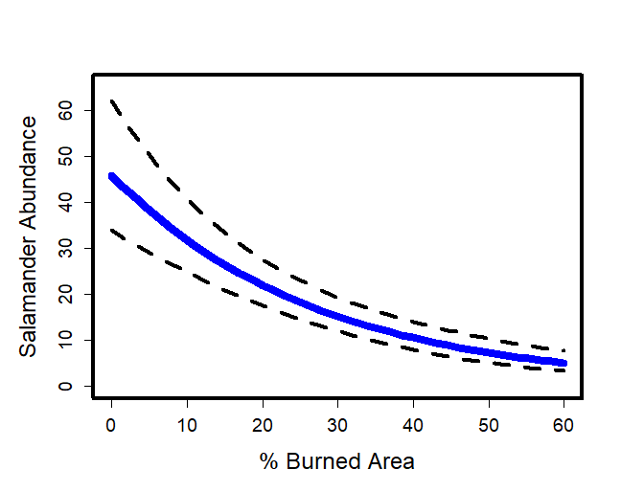
Estimating Abundance – Closed Binomial N-mixture Model
1. Question
How does wildfire influence salamander abundance?
iNaturalist, USDA Forest Service, Burned Area Emergency Response Team

Slide 30
Estimating Abundance – Closed Binomial N-mixture Model
Group 1:
What was our site-level covariate?
What was our observational covariate?
Can detection be modeled as a function of the site-level covariate?
Can abundance be modeled as a function of the observational covariate?
Group 2:
Describe the relationship between % burned area and salamander abundance…
What was the mean predicted abundance when percent burned area was 12%?
Group 3:
Describe the relationship between time of day and salamander detection…
What is the mean predicted detection probability for surveys conducted at 10am?

Slide 31
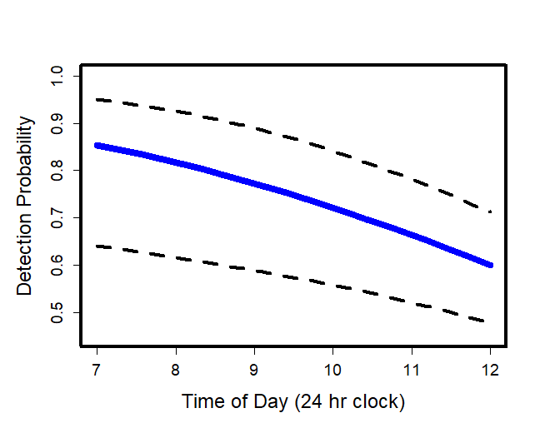
Estimating Abundance – Closed Binomial N-mixture Model
1. Question
How does wildfire influence salamander abundance?
iNaturalist, USDA Forest Service, Burned Area Emergency Response Team

Slide 32
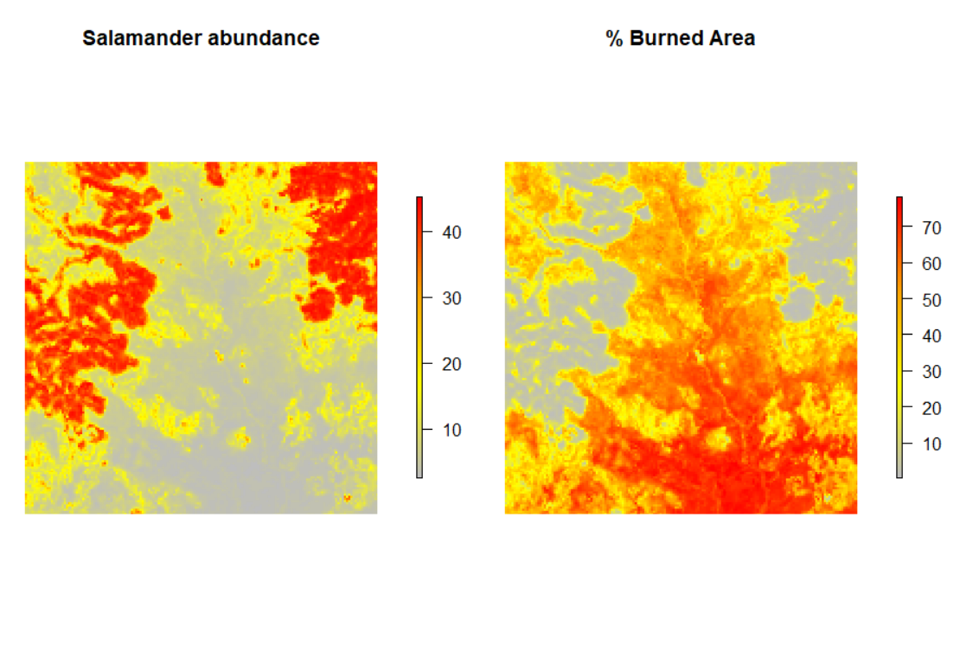
Estimating Abundance – Closed Binomial N-mixture Model
1. Question
How does wildfire influence salamander abundance?

Slide 33
Estimating Abundance – Closed Binomial N-mixture Model
Any questions?
Does anyone want to go over anything again?

Slide 34
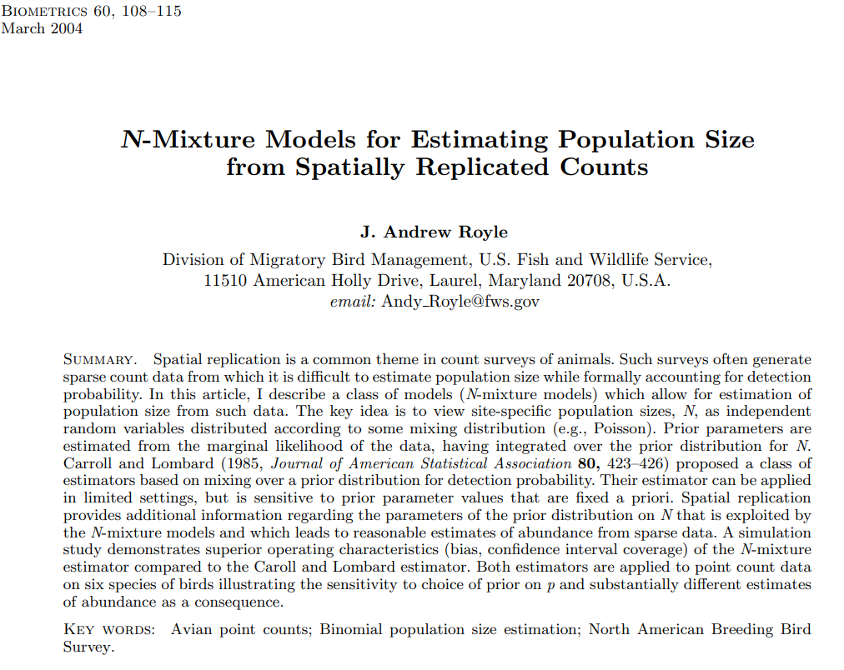
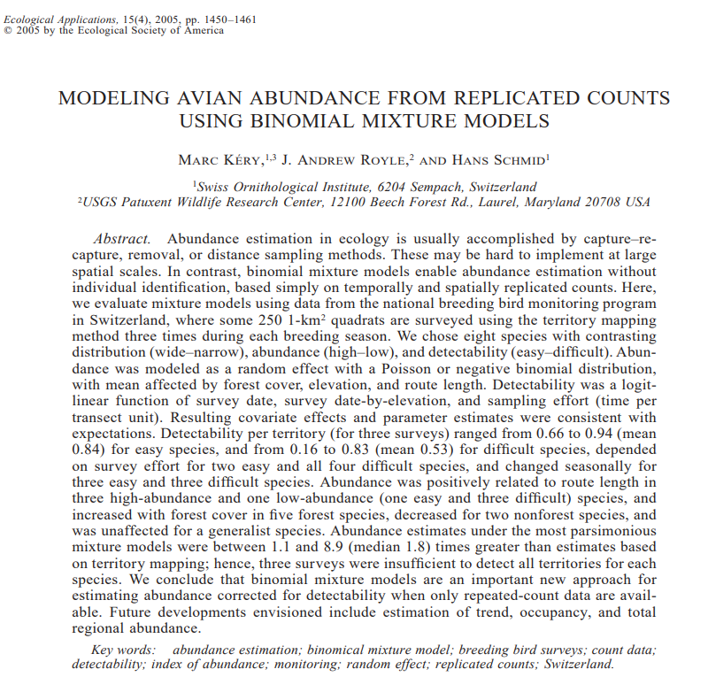
Estimating Abundance – Closed Binomial N-mixture Model

Slide 35
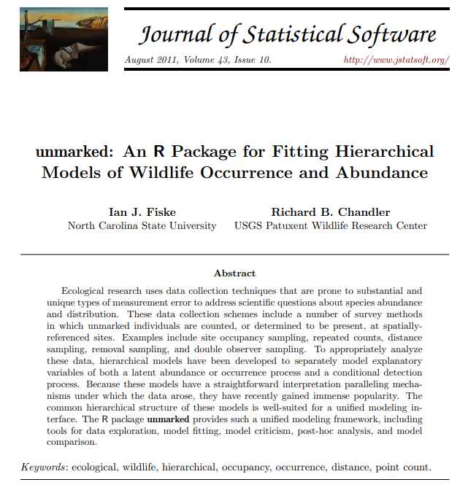
Estimating Abundance – Closed Binomial N-mixture Model

